Slide 1
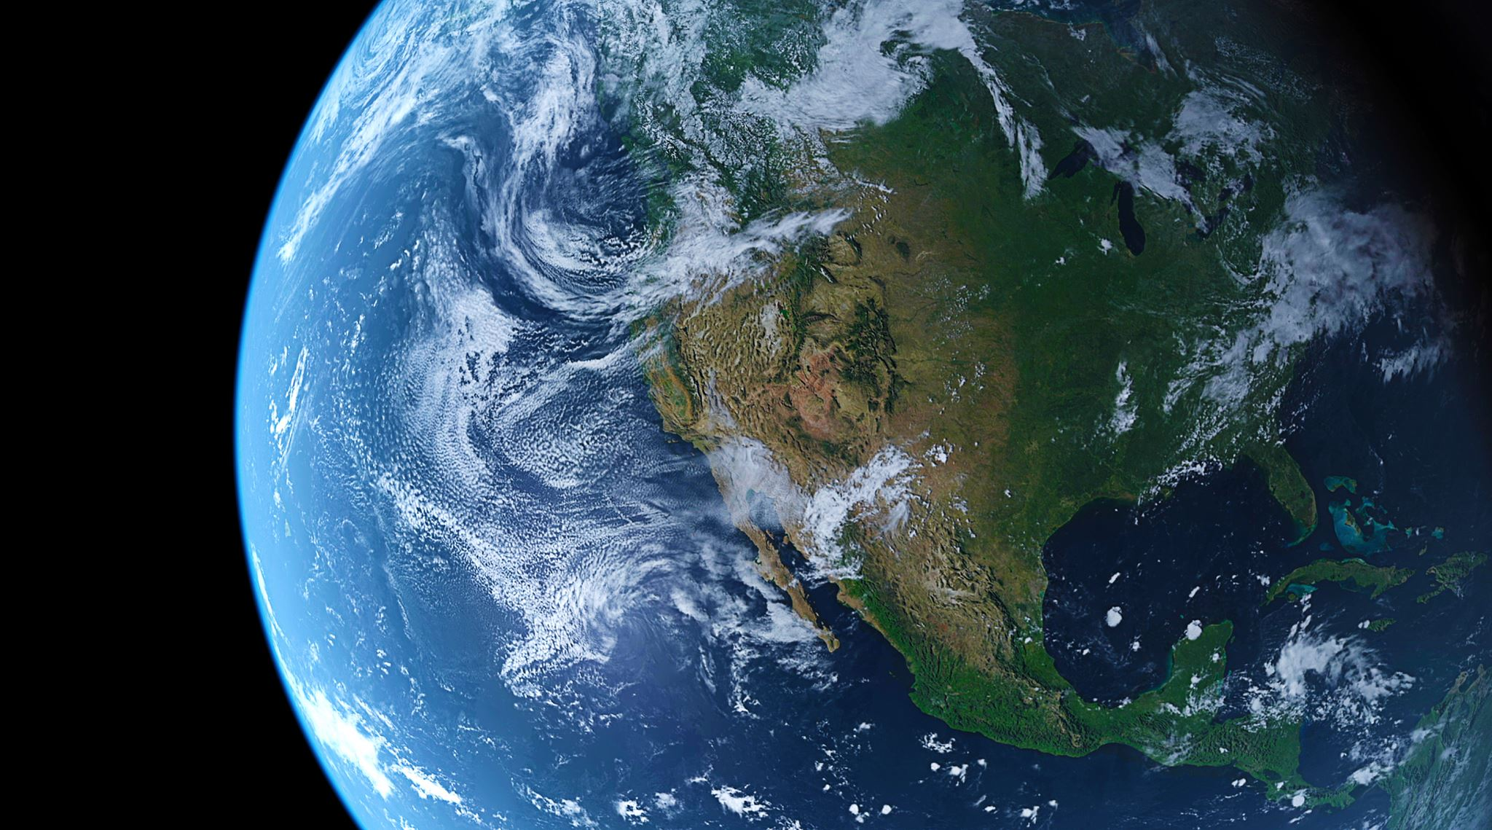
Community, Climate, and Communication: A GREAT Combination
Dr. Diane Stanitski
SUNY Geneseo Alumna ‘89

Slide 4
“There’s no learning in the comfort zone, and there’s no comfort in the learning zone.”
~Walt Childress

Slide 5
Civilian Climate Corps

